Slide 1

Capstone Project
Vietnamese Medicinal Plants Network

Slide 2
Vietnamese Medicinal Plants Network
Capstone Project
Instructor
TiếnNM
ĐăngNH
Instructor
Role
Role
KhánhTB
QuỳnhHT
Table of Content
Role
Role
Introduction
Blah blah
Bleh bloh
…

Slide 3
Vietnamese Medicinal Plants Network
Instructor
TiếnNM
ĐăngNH
Instructor
Leader
Developer
KhánhTB
QuỳnhHT
Table of Content
Developer
Tester
Introduction
Software Management
SRS
…

Slide 4
Introduction -
Software Management
Software Requirement Specification
Software Design Description
Quality Control
Project Result
Demo
Q & A
Table of Content
Name Name Name Name Name Name Name Name

Slide 5
Introduction
Current Situation - 現在状況
The Idea - アイデア
Proposal - 提案
Benefit From Project - プロジェクト便益

Slide 6

Introduction
Nhật
Current Situation - 現在状況
The Idea - アイデア
Proposal - 提案
Benefit From Project
Thanks to the development of the medicine

Slide 7

Introduction
Nhật
Current Situation - 現在状況
The Idea - アイデア
Proposal - 提案
Benefit From Project
Thanks to the development of the medicine
Misuse on medicine

Slide 8
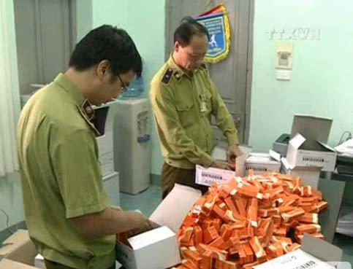
Introduction
Nhật
Current Situation - 現在状況
The Idea - アイデア
Proposal - 提案
Benefit From Project
Thanks to the development of the medicine
Misuse on medicine
Counterfeit drugs

Slide 9

Introduction
Nhật
Current Situation - 現在状況
The Idea - アイデア
Proposal - 提案
Benefit From Project
Community health

Slide 10
Introduction
Nhật
Current Situation - 現在状況
The Idea - アイデア
Proposal - 提案
Benefit From Project
Build a website
Used technology MySQL, PHP, Laravel framework…
Provide and share useful medicinal plants and traditional remedy for user
Completely support Vietnamese user.
Improve team member
Development, management, teamwork skill
Technical experience

Slide 11
Introduction
Nhật
Current Situation - 現在状況
The Idea - アイデア
Proposal - 提案
Benefit From Project -プロジェクト便益
Criteria | Thuocnam.org | Tuelinh.vn | Caythuoc.info
View information | x | x | x
Contribute new article
Comment an article | x | x | x
Like an article |  | x | x
Share an article |  | x | x
Report an article
Rate an article
Search an article |  | x | x
View herbal medicine store

Slide 12

Introduction
Project Management
Name Name Name Name Name Name Name Name
Current Situation - 現在状況
The Idea - アイデア
Proposal - 提案
Benefit From Project - プロジェクト便益

Slide 13
Introduction
Project Management
Software Process Model - ソフトウェアプロセスモデル
Project Organization - プロジェクト組織
Project Schedule - プロジェクト計画
Objectives & deliverables - 目標と成果物
Tools & Infrastructure - ツールと インフラストラクチャ
Risks management - リスク管理
Configuration management - コンフィグレーション管理
Communication management - コミュニケーション管理

Slide 14
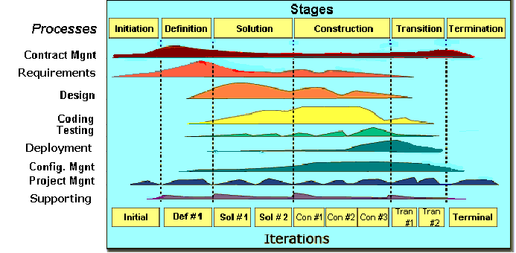
Introduction
Project Management
Software Process Model - ソフトウェアプロセスモデル
FPT Software Process Model

Slide 15
Introduction
Project Management
Software Process Model - ソフトウェアプロセスモデル
Initiation | Identify business functions of the system Determine scope, condition, limitation, project risk List main functions Complete Report #1
Solution | Complete SRS, Architecture Design and Database Design Complete Report #2
Construction | Report #3, Report #4 Complete Coding and Testing
Termination | Complete software packages and Report #5, Report #6 Preparing presentation Complete Project
Project Life Cycle

Slide 16
Introduction
Project Management
Project Organization - プロジェクト組織
Nguyễn Văn Sang
Instructor
Nguyễn Minh Tiến
Project Manager
Nguyễn Minh Tiến
Technical Leader
Trần Bình Khánh
Developer
Trần Bình Khánh
Tester
Nguyễn Hải Đăng
Developer
Hoàng Thị Quỳnh
Test Leader/QA
Nguyễn Minh Tiến
Design Leader
Nguyễn Hải Đăng
Designer

Slide 17
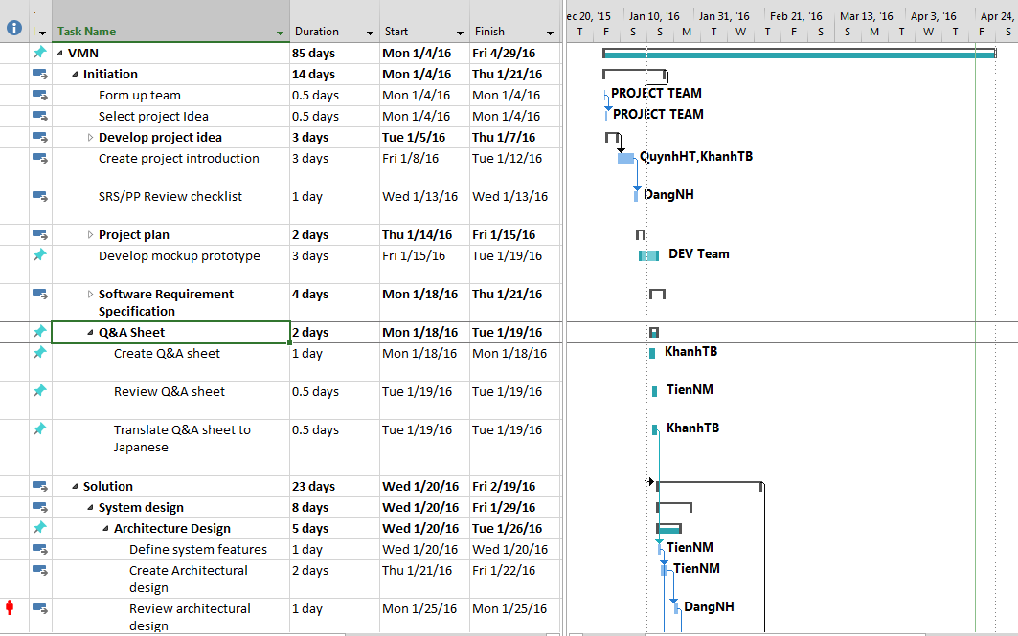
Introduction
Project Management
Project Schedule - プロジェクト計画

Slide 18
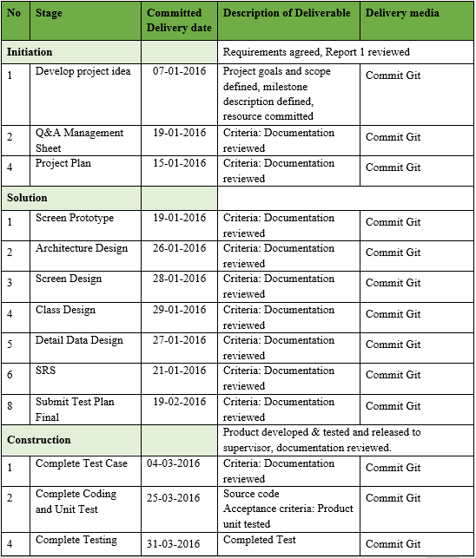
Introduction
Project Management
Objectives & deliverables - 目標と成果物

Slide 19












Introduction
Project Management
Tools & Infrastructure - ツールと インフラストラクチャ
Tools for Project Management
Tools for Developing
GitHub
Word 2013
Excel 2013
Project 2013
Slack
Trello
Visual Paradigm
PHP Storm
Chrome
Firefox
Sublime Text
Astah

Slide 20
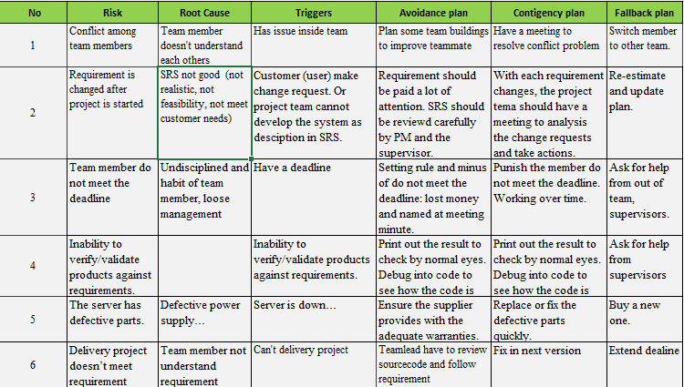
Introduction
Project Management
Risks management - リスク管理

Slide 21
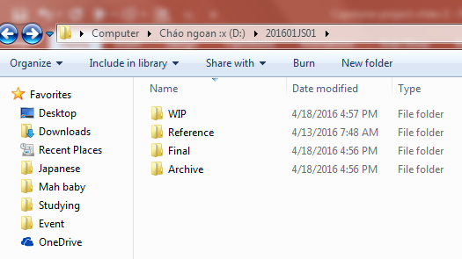
Introduction
Project Management
Configuration management - コンフィグレーション管理
Final: Store sent and delivered documents
References: Store reference documents.
For example: templates, technologies document…
WIP: Store documents in progress developing
Plan: Plan of capstone project
Users: Working Folder of Member
Documents: Store whole documents in progress developing
Records: Store documents like Meeting Minutes, Q & A Management…
Folder Structure

Slide 22
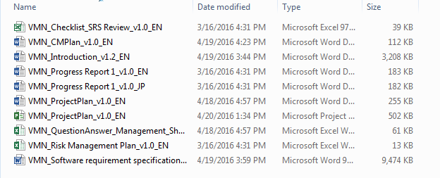
Introduction
Project Management
Configuration management - コンフィグレーション管理
Rule
ProjectCode_Document’s name_v<x.x>_language
ProjectCode: FA{
Document’s name:
Architecture Design, Class Design…
v<x.x>: document’s version.
For example: v1.0, v1.1,…
Language:
EN: English
JP: Japanese
Naming Convention

Slide 23
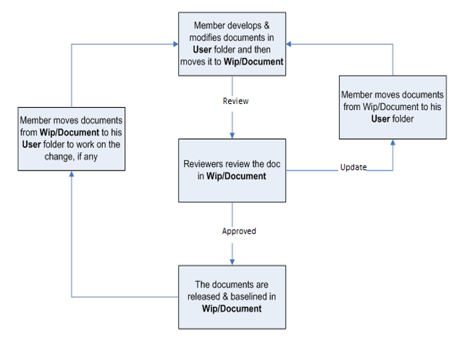
Introduction
Project Management
Configuration management - コンフィグレーション管理

Slide 24
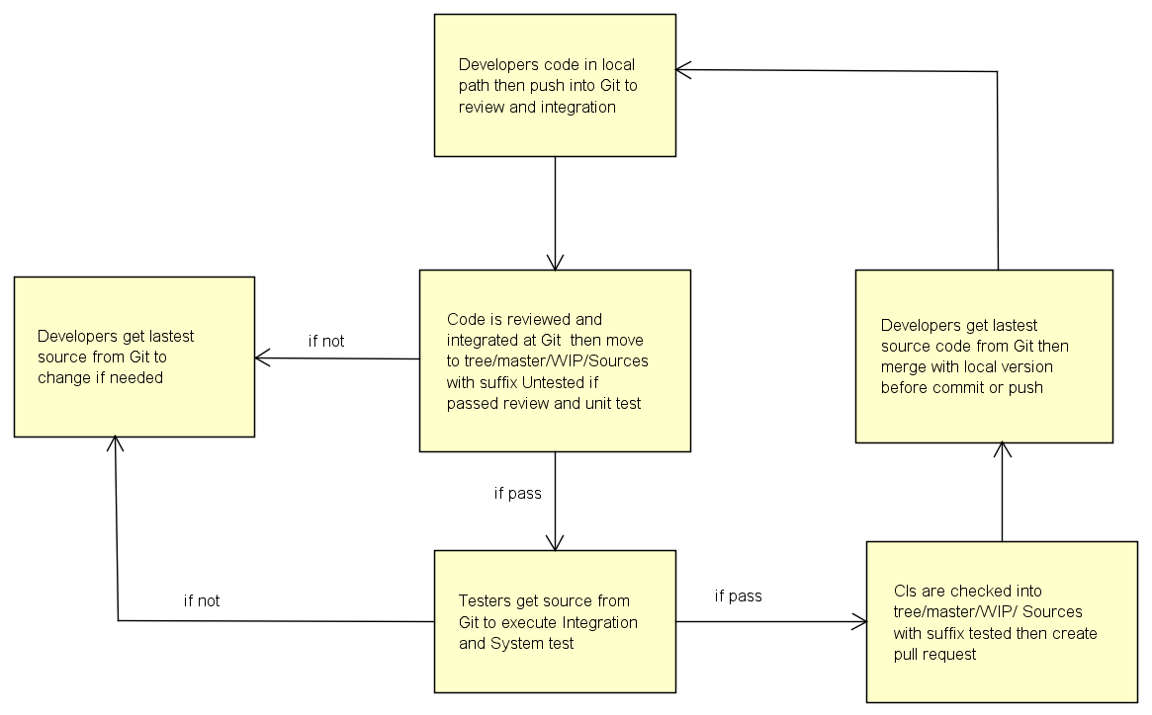
Introduction
Project Management
Configuration management - コンフィグレーション管理

Slide 25







Introduction
Project Management
Communication management - コミュニケーション管理
Time
4h/day, 5 days/week
Location
Communication
Meeting minutes

Slide 26
Introduction
Project Management
Software Requirement Specification
Functional Requirements - 機能要求
Non-functional Requirements - 非機能要求

Slide 27
Introduction
Project Management
Software Requirement Specification
Functional Requirements - 機能要求
Authentication Functions Group
Medicinal Plants Functions Group
Remedy Functions Group
Herbal Medicine Store Functions Group
Member Functions Group
Mod Functions Group

Slide 28
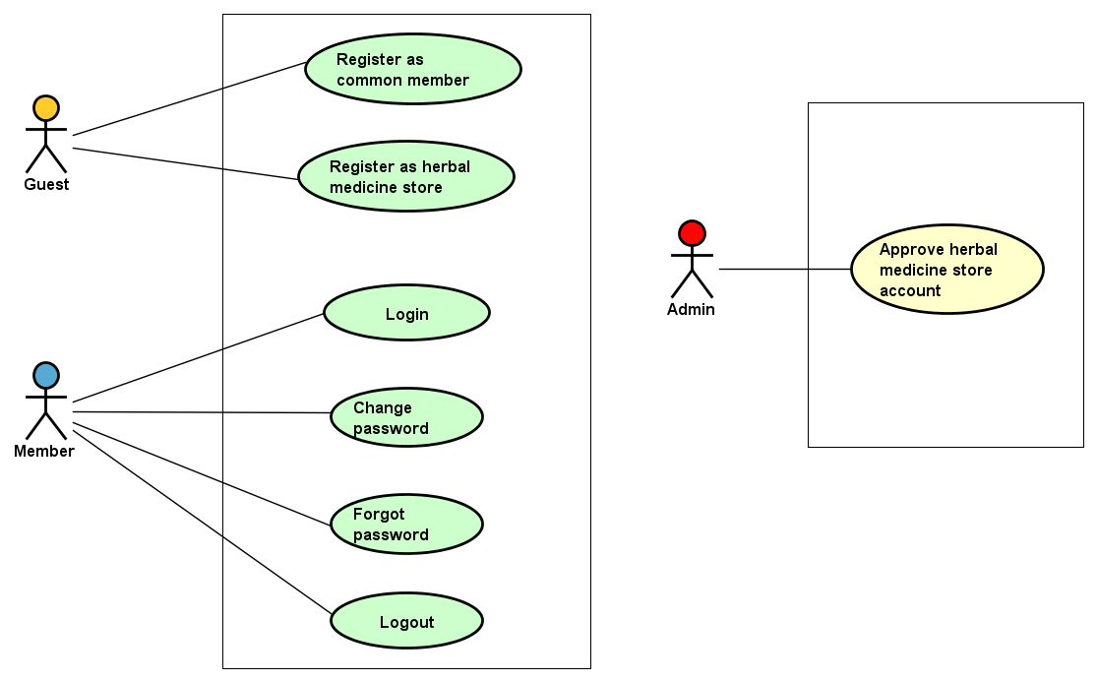
Introduction
Project Management
Software Requirement Specification
Functional Requirements - 機能要求
Authentication Functions Group

Slide 29
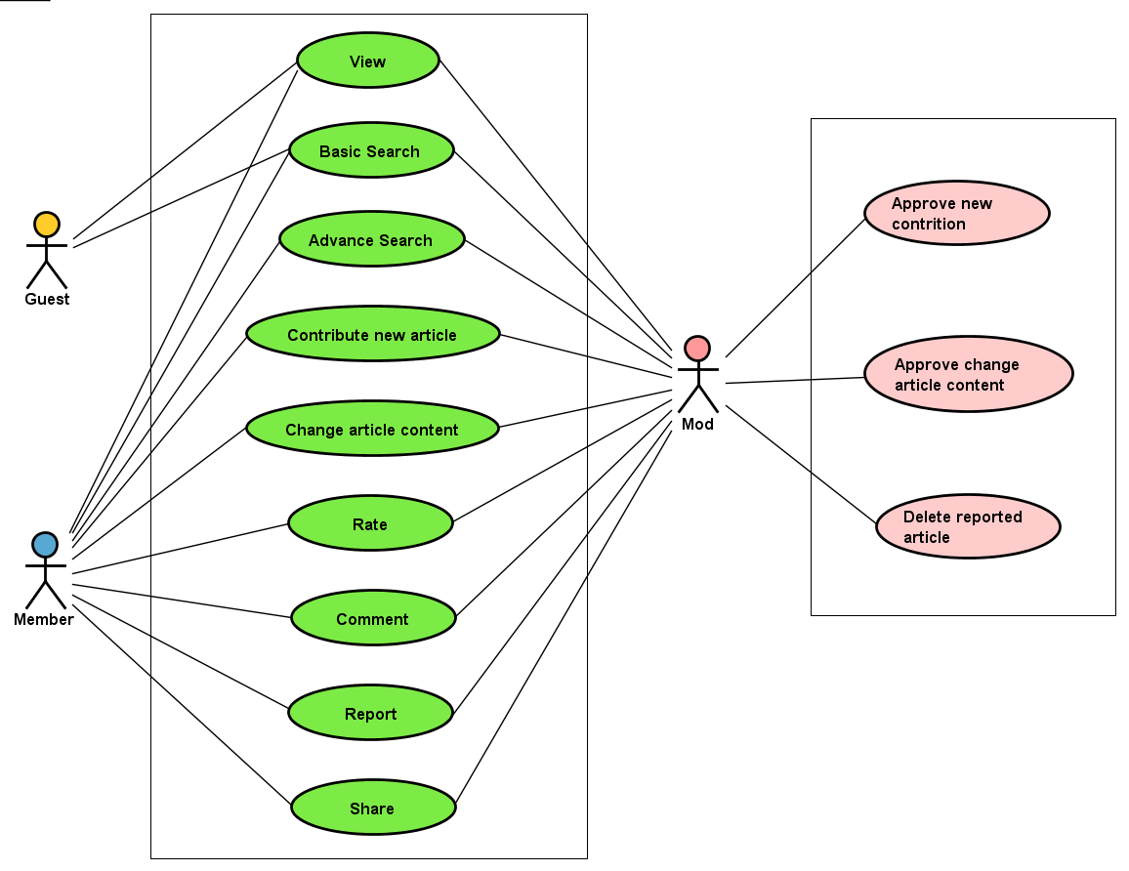
Introduction
Project Management
Software Requirement Specification
Functional Requirements - 機能要求
Authentication Functions Group
Medicinal Plants Functions Group
Remedy Functions Group

Slide 30
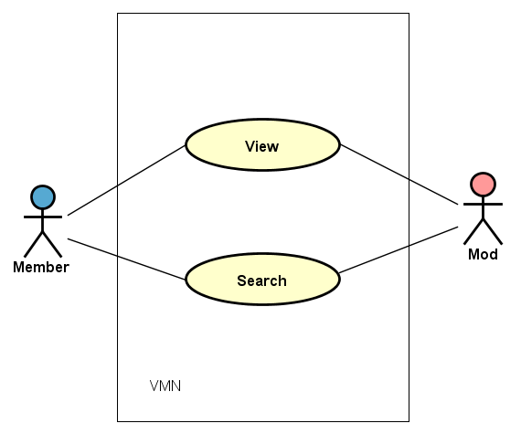
Introduction
Project Management
Software Requirement Specification
Functional Requirements - 機能要求
Authentication Functions Group
Medicinal Plants Functions Group
Remedy Functions Group
Herbal Medicine Store Functions Group

Slide 31
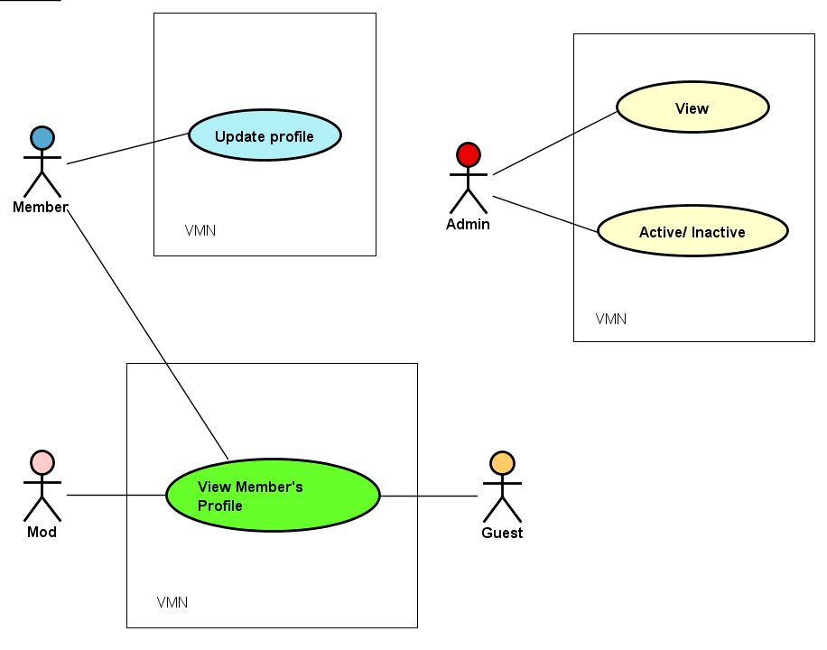
Introduction
Project Management
Software Requirement Specification
Functional Requirements - 機能要求
Authentication Functions Group
Medicinal Plants Functions Group
Remedy Functions Group
Herbal Medicine Store Functions Group
Member Functions Group

Slide 32
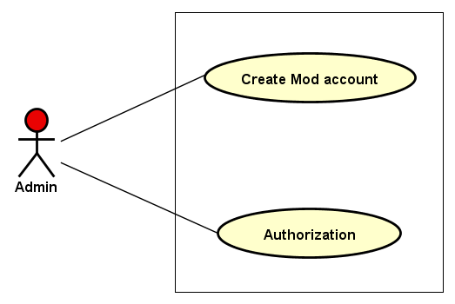
Introduction
Project Management
Software Requirement Specification
Functional Requirements - 機能要求
Authentication Functions Group
Medicinal Plants Functions Group
Remedy Functions Group
Herbal Medicine Store Functions Group
Member Functions Group
Mod Functions Group

Slide 33
Introduction
Project Management
Software Requirement Specification
Non-functional Requirements - 非機能要求
Performance Requirements Availability
The application must be available 95% of time. Users can access to it everywhere from their Web browser with internet connection.

Slide 34
Introduction
Project Management
Software Requirement Specification
Non-functional Requirements - 非機能要求
Performance Requirements Availability
The application must be available 95% of time. Users can access to it everywhere from their Web browser with internet connection.
Response time
In term of response time, waiting time of processing will be 2 to 3 seconds.

Slide 35
Introduction
Project Management
Software Requirement Specification
Non-functional Requirements - 非機能要求
Performance Requirements Availability
The application must be available 95% of time. Users can access to it everywhere from their Web browser with internet connection.
Response time
In term of response time, waiting time of processing will be 2 to 3 seconds.
Usability
User can complete each function in less than 6 actions.

Slide 36
Introduction
Project Management
Software Requirement Specification
Non-functional Requirements - 非機能要求
Performance Requirements Availability
The application must be available 95% of time. Users can access to it everywhere from their Web browser with internet connection.
Maintainability
Coding standards and naming conventions:
Output of the project must include coding standards and naming conventions documentations; Implementation code must be easy to maintain;
If some components are reused, the documentations of those components must also be included;
Identifiers should be match with business
Design:
The design of the system must be loosely coupled
Follow SOLID design and project business
Mean time to repair:
Immediately when Administrator finds out problem. Average 3 days.
Response time
In term of response time, waiting time of processing will be 2 to 3 seconds.
Usability
User can complete each function in less than 6 actions.

Slide 37
Introduction
Project Management
Software Requirement Specification
Non-functional Requirements - 非機能要求
Performance Requirements Availability
Security Requirement
VMN website is divided into 2 groups of user: inner user (Admin, Mod) and outer user (common Member, herbal medicine store).
Response time
Usability
Maintainability

Slide 38


Introduction
Project Management
Software Requirement Specification
Non-functional Requirements - 非機能要求
Software requirement
Hardware requirement

Slide 39
Software Design Description
Name Name Name Name Name Name Name Name
Architectural Representation – アーキテクチャ表現
Package View - パッケージ ビュ
Database Design - データベース設計
Screen Flow - 画面の流れ
Screen Design - 画面設計
Class Design - クラス設計
Sequence Diagram - シーケンス図

Slide 40
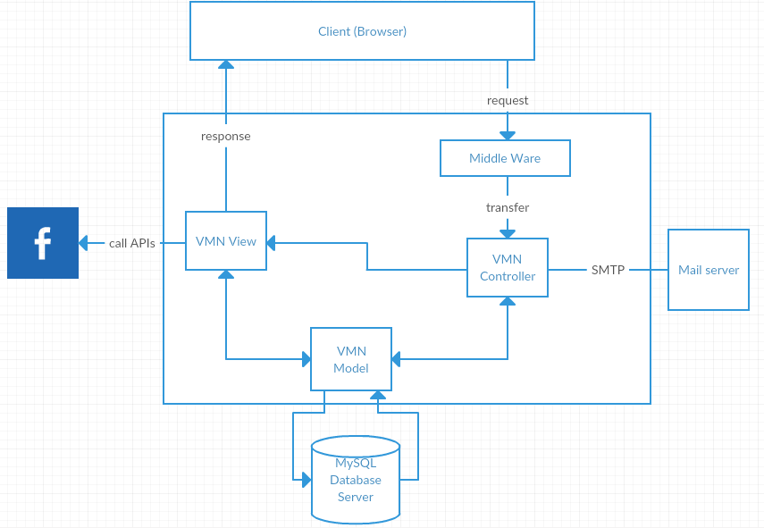
Software Design Description
Architectural Representation – アーキテクチャ表現
Technology:
PHP Laravel Framework
VMN System Overall Architecture-VMN システム全体のアーキテクチャ

Slide 41
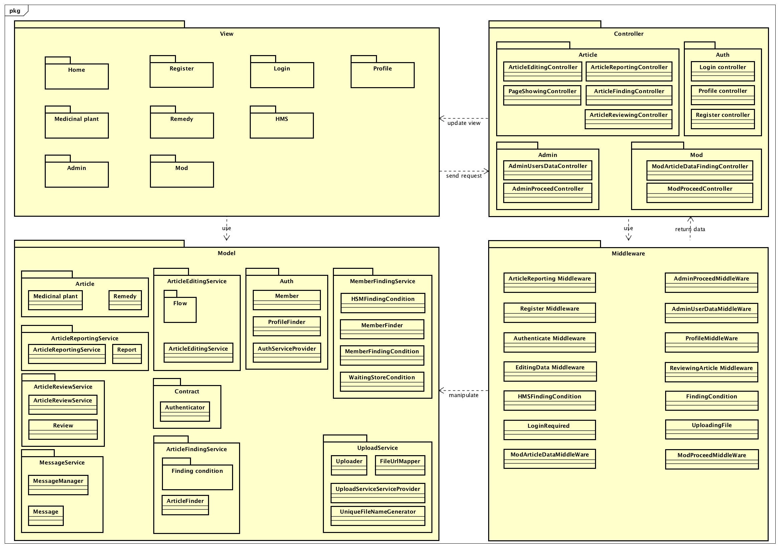
Software Design Description
Package View - パッケージ ビュ
Package View - パッケージ ビュー

Slide 42
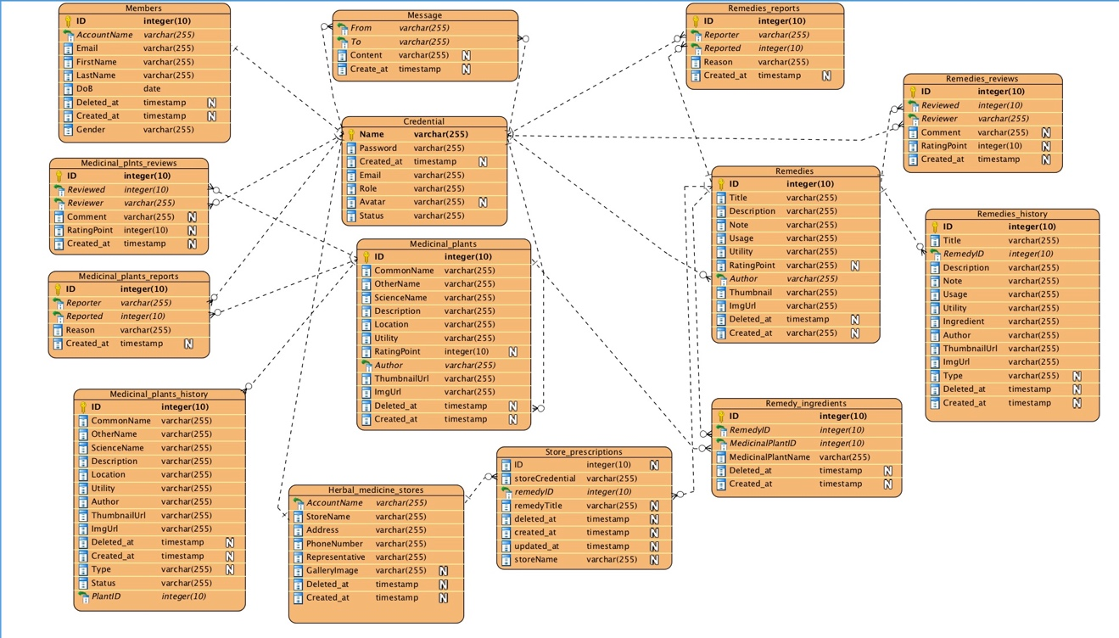
Software Design Description
Database Design - データベース設計

Slide 43
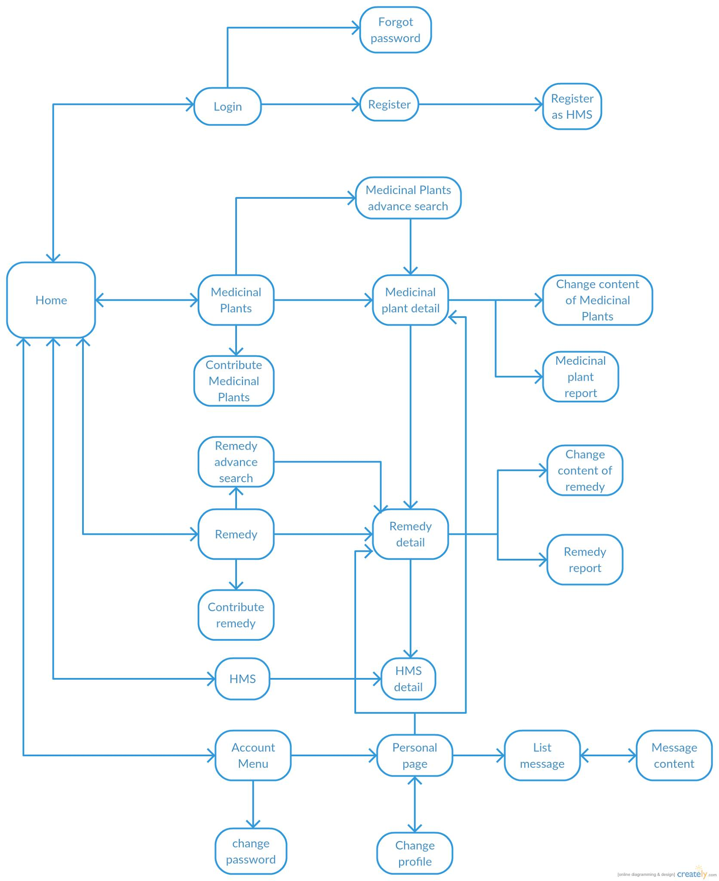
Software Design Description
Screen Flow - 画面の流れ

Slide 44
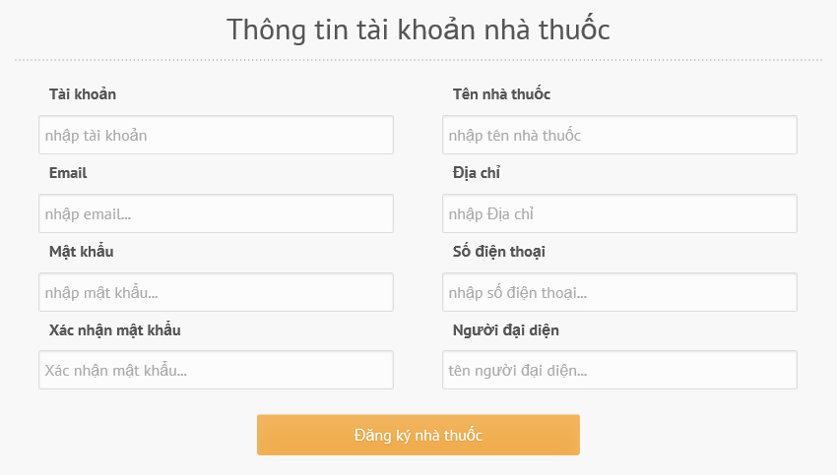
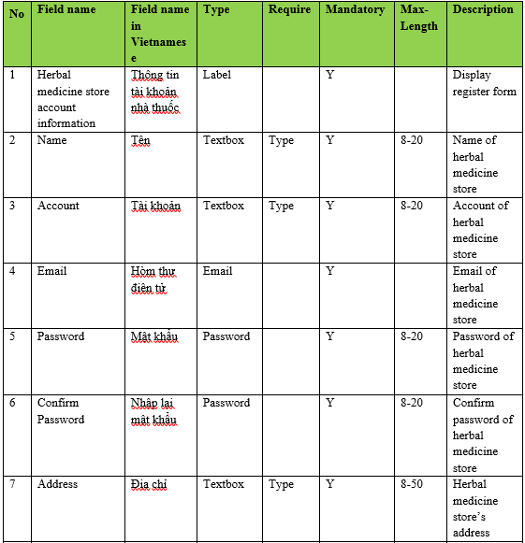
Software Design Description
Screen Design - 画面設計
Register as HMS account screen design

Slide 45
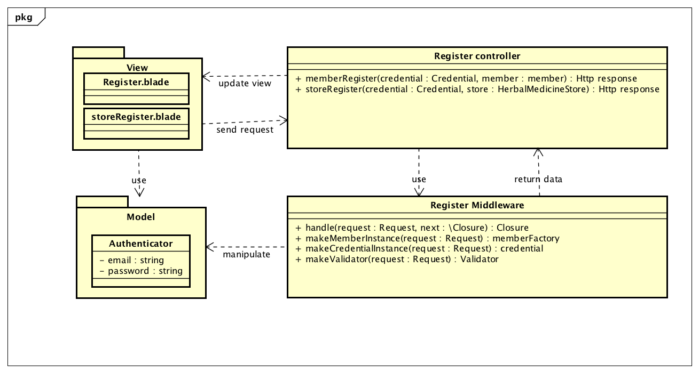
Software Design Description
Class Design - クラス設計
Register Class Diagram

Slide 46
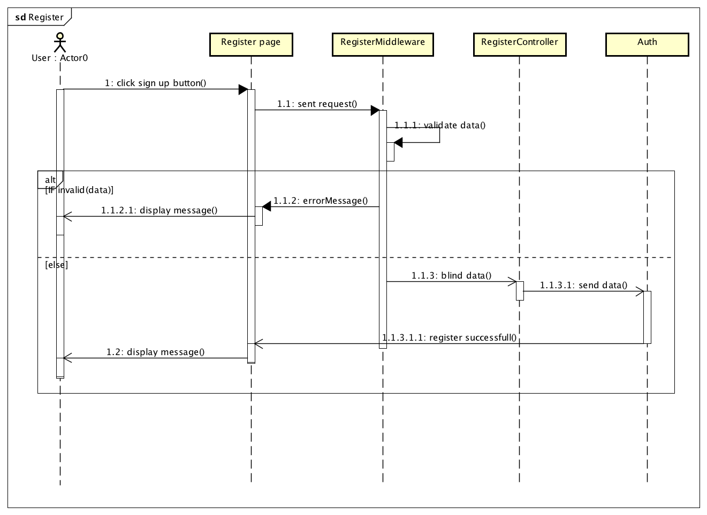
Software Design Description
Sequence Diagram - シーケンス図
Register Sequence Diagram

Slide 47
Introduction
Project Management
A
Quality Management
Name Name Name Name Name Name Name Name
Test Model - 試作機
Test Process - 試験過程
Test Criteria - テスト基準
Test Tools - テストツール
Test Environment - テスト環境
Test Phases - テストフェーズ
Bug Logging Process (Based on Fsoft)
プロセスロギングバグ（FSoftに基づきます）
Bug List report - バグリストレポート

Slide 48
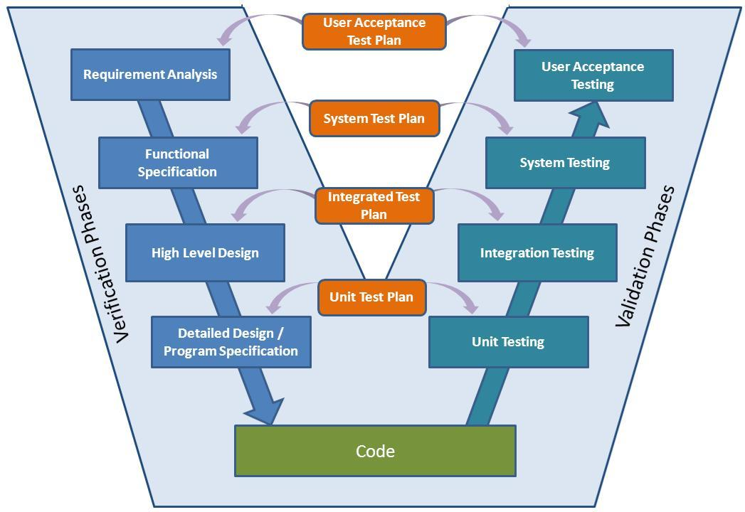
In
Quality Management
1. Test Model-

Slide 49
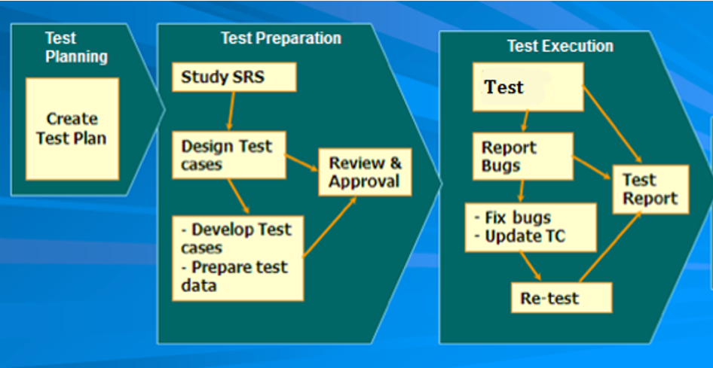
In
Quality Management
2. Test process-テストのプロセス

Slide 50
In
Quality Management
3. Test Criteria
Unit test:
Statement coverage: 100%
Branch coverage: 100%
Path coverage: 100%
System test:
Number of TC/function: 20 TC/function
Number defects/function: 1-2 defects/function
Integration test:
Number of TC/function: 10 TC/function
Number defects/function: 2 defects/function
Acceptance test:
Number defects/function: 1-2 defects/function

Slide 51


In
Quality Management
4. Test Tools
Postman
Use for estimate response time
Check data output
Trello
Manage bugs
Manage testing task

Slide 52





In
Quality Management
Test Environment - テスト環境
Device: Laptop
Operating System
Win7
Os X Capitan

Slide 53
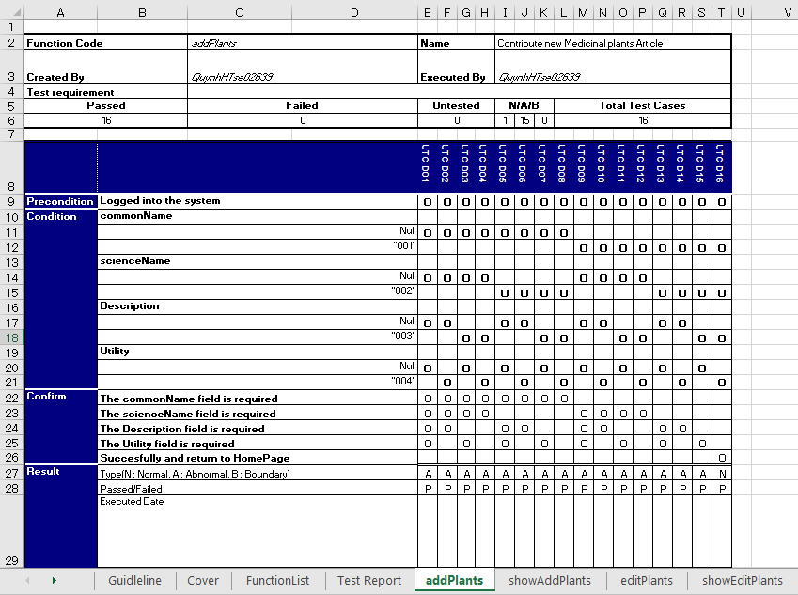
In
Quality Management
Test Phases - テストフェーズ
Unit Test

Slide 54
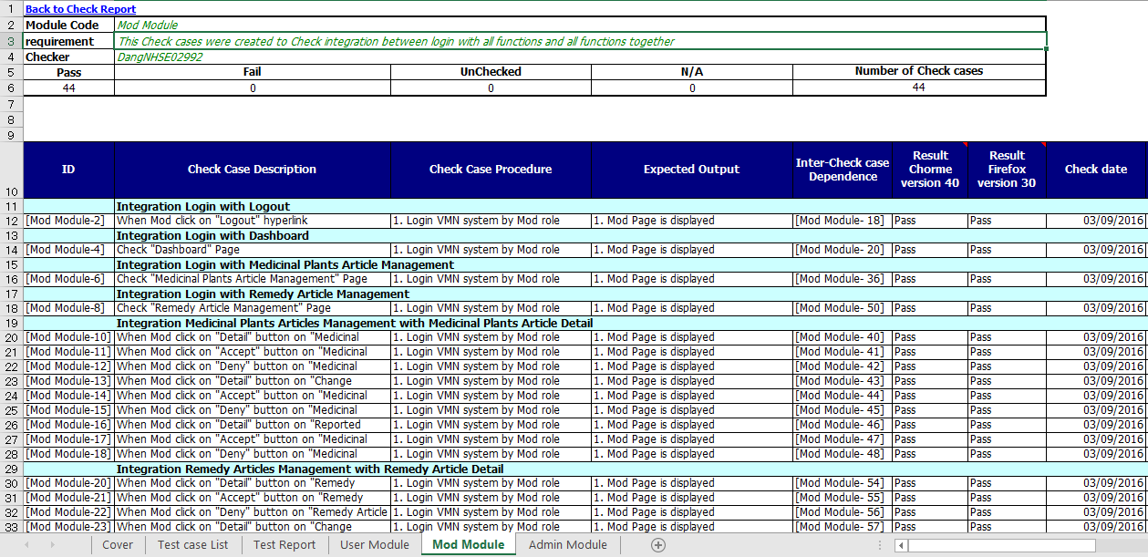
In
Quality Management
Test Phases - テストフェーズ
Integration test case

Slide 55
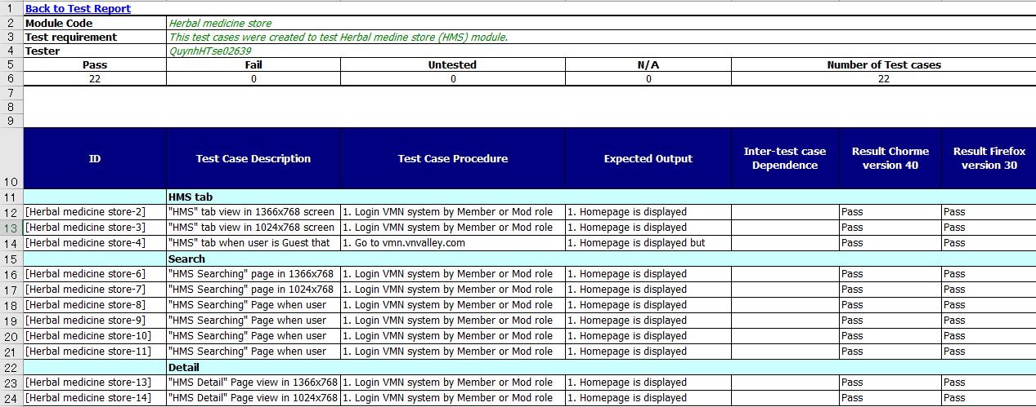
In
Quality Management
Test Phases - テストフェーズ
System test case

Slide 56
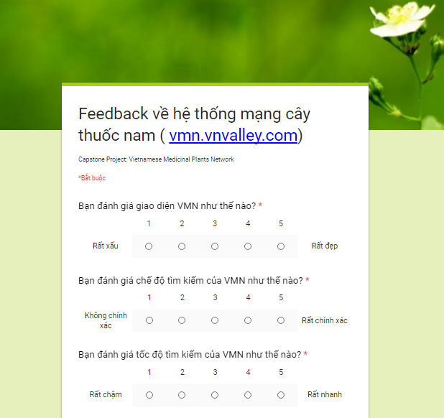
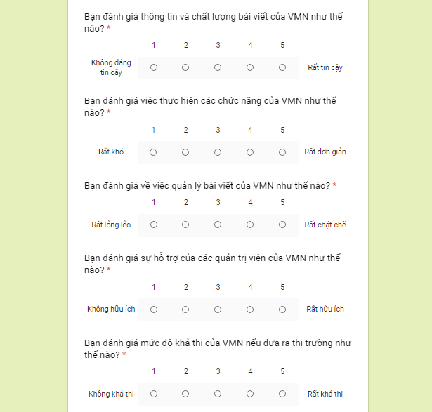
In
Quality Management
Test Phases - テストフェーズ
Acceptance test

Slide 57
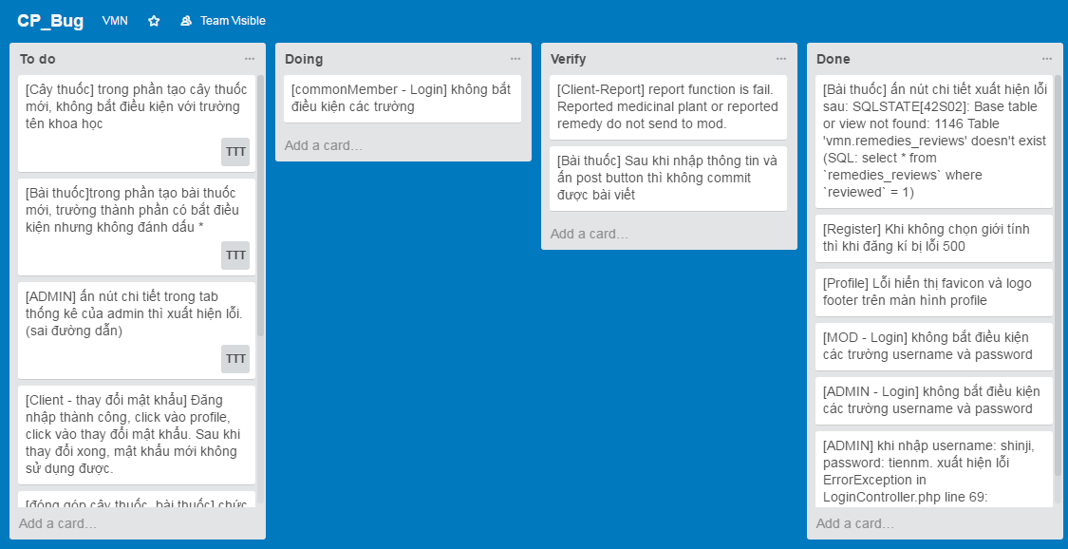
In
Quality Management
7. Process Logging Bug

Slide 58
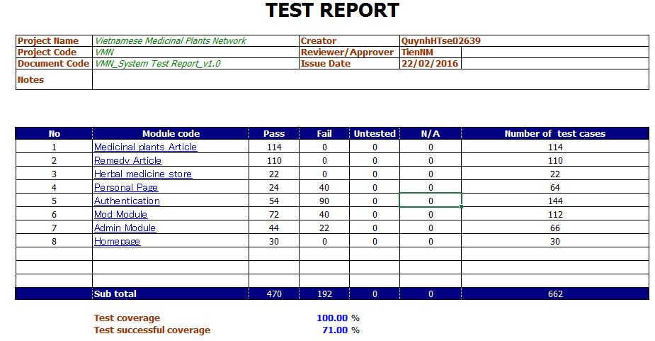
In
Quality Management
Test report -トレポート
Test report round 1

Slide 59
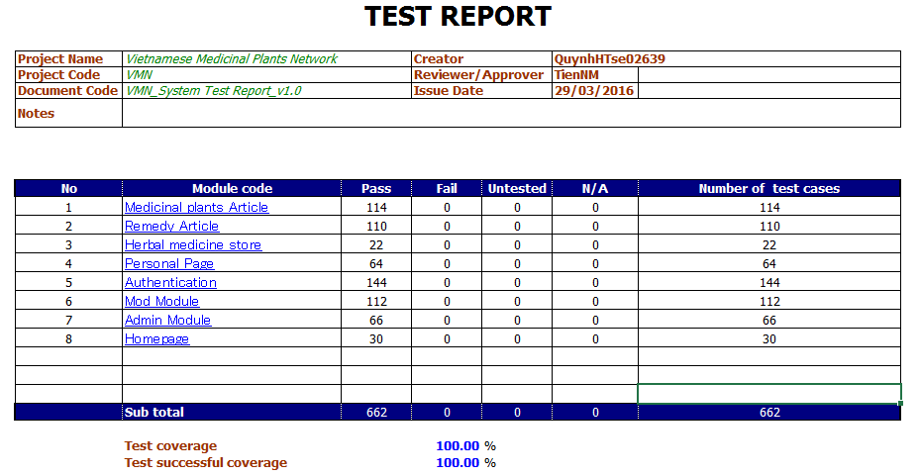
In
Quality Management
Test report -トレポート
Test report round 2

Slide 60
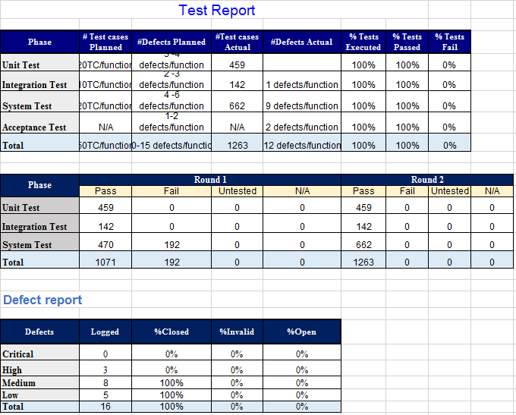
In
Quality Management
Test report -トレポート
Final Test report

Slide 61

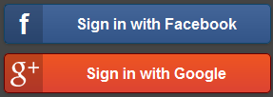

In
Project Result
Project summary
Future Development
Build rank member’s function
Build search medicinal plants or remedy by diseases function
Login through Facebook, G+, Twister
Open website for advertising
App for Android, IOS and Window phone

Slide 62
In
Project Result
Project summary
Knowledge
Working process of FPT Software to develop a project.
Putting the learned knowledge into practice.
Improve skils: teamwork, leader-ship, research and self-study, make plan and manage time.
Technical: PHP, Laravel Framework, Domain Driven Development.
Tools: Visual Paradigm, Git, Astah, Office tools, Trello, Slack.

Slide 63



In
Project Result
Project summary
Lesson Learn
Working in group and working individual.
Putting knowledge into practice.
Manage time and make the plan.
Be open to get the better opinions from other member.
Limit and resolve conflicts between members.

Slide 64

In
Demo

Slide 65

In
Q & A -質問と回答

